Slide 1
Welcome to Technical Bootcamp: Day 4

Slide 2

A look into the Day 4 agenda
Day 4
8:00
Challenge Introduction
8:15
Begin POC Challenge
8:45
Please refer to the descriptions below for reference
9:00
Types of activities:
Attendees will participate in four different types of activities:
Break
10:00
Continue POC Challenge
11:00
Keynote
Labs
Break
11:15
Continue POC Challenge
Presentations
Challenges
Teams Cohort Activities
12:00
Lunch
Location of activities:
Each activity will take place in the following location:
13:00
Finish POC Challenge
13:30
14:00
Challenge Debrief
All-up Session: Teams bridge in calendar invite
Closing
Teams Cohort: “Meet Now” function in Teams Cohort Teams channel
15:00
Independent working time: No meeting, working in Spektra labs

Slide 3






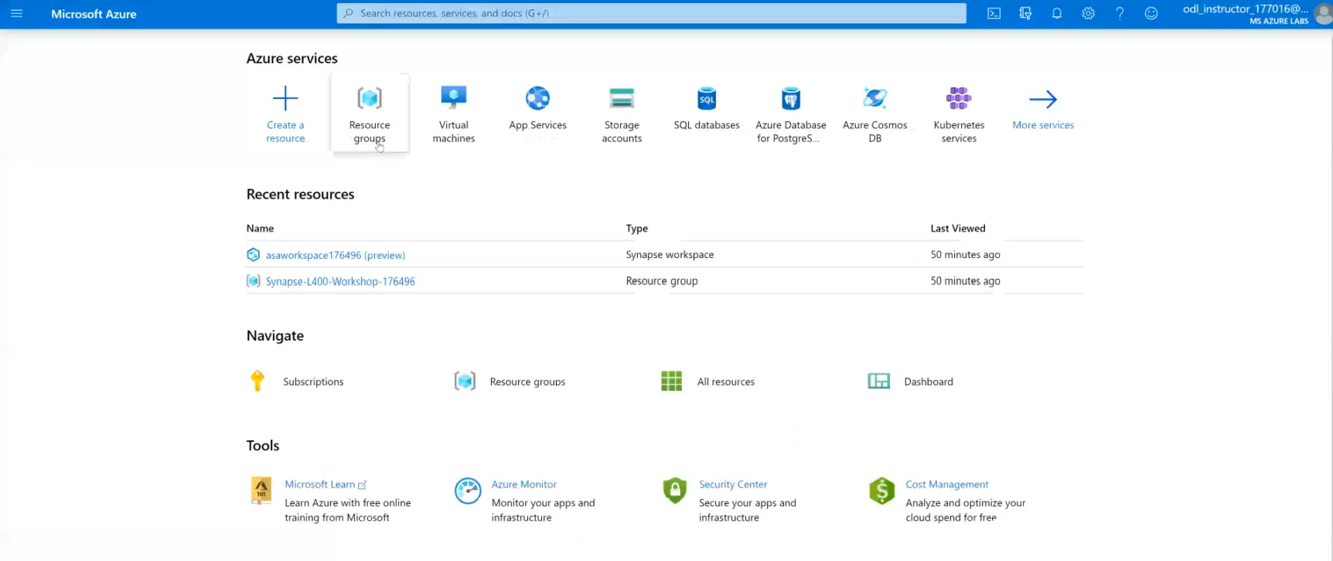

POC Challenge: group-based lab exercise
GUIDE:
PoC Challenge
https://github.com/solliancenet/data-ai-technical-bootcamp/
Step 1: Go to your table group channel
Step 2: You will use your cloud lab login for Azure
Step 3: Login to Azure. Engage your table group via a Microsoft Teams “meet now” call to collaborate with each other (meet now button in upper right corner of application)

Slide 4

What we covered and how to continue to learn
Thank you for participating
What was covered this week:
Together we learned how to develop performant Azure Synapse Analytics proof-of-concepts using the latest functionality for data ingestion, transformation, query optimization, security, monitoring, and machine learning.
How to keep learning:
Watch and learn with Microsoft Build
Explore Microsoft.com/learn for on-demand learning
Connect with us in our upcoming Architecture Design series (details coming in June)

Slide 5
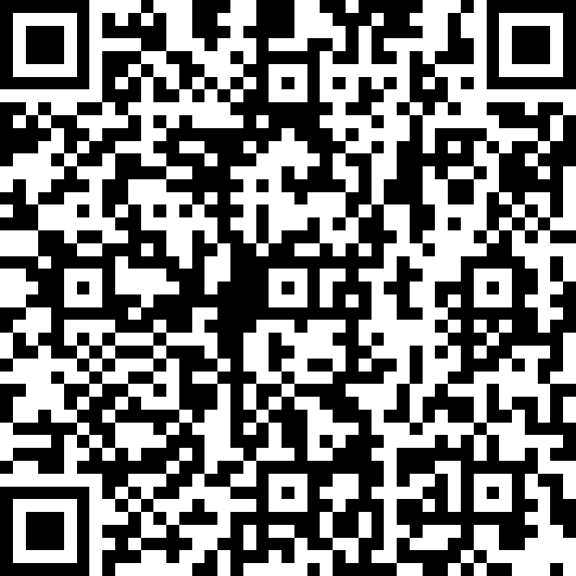
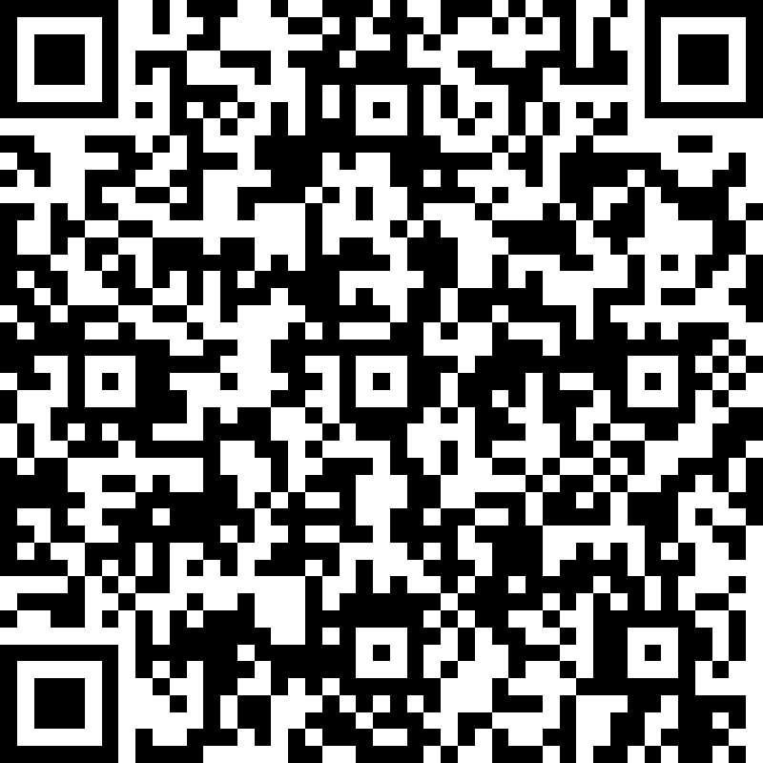
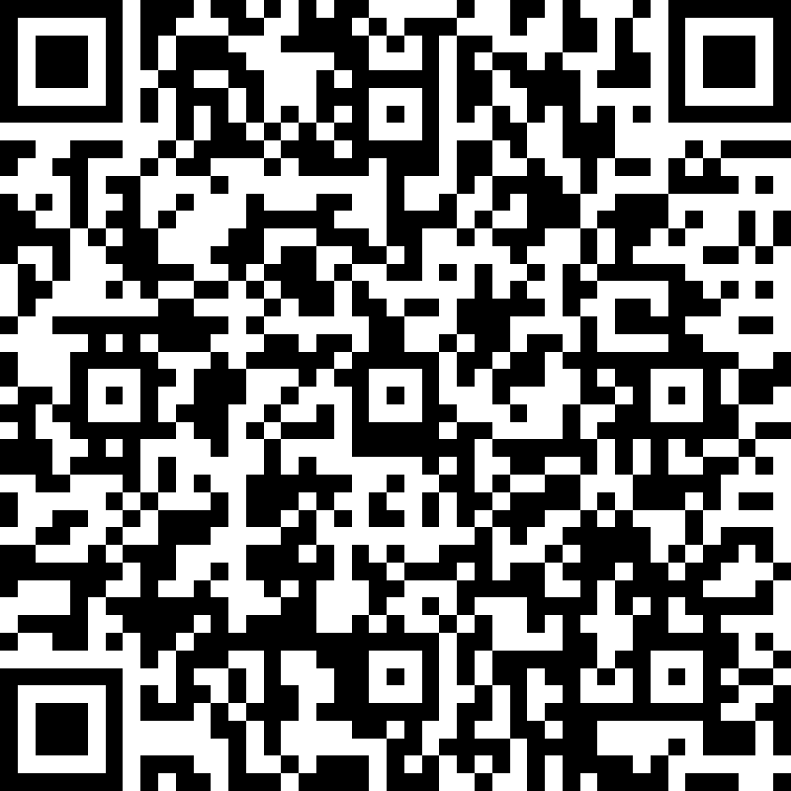
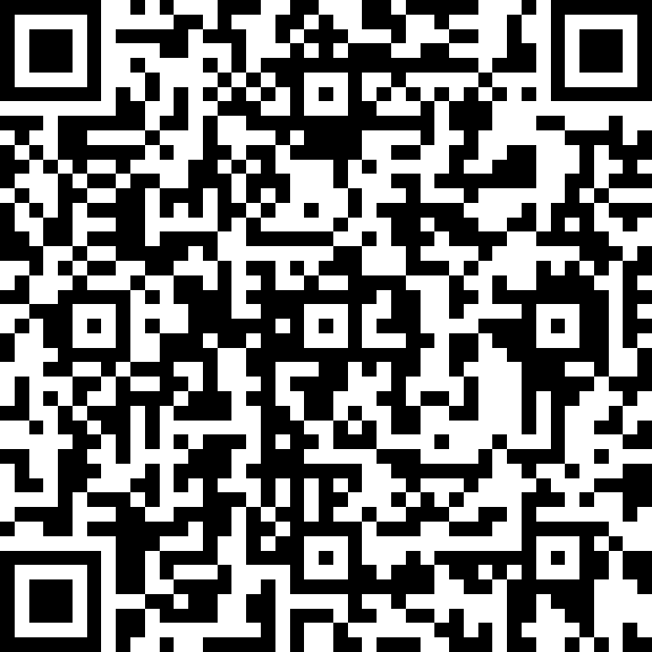
We’d love to hear from you!
Day 1 | Day 2 | Day 3 | Day 4
Scan the QR code below using your smartphone or access the link https://aka.ms/BC_EMEA_Day1 You’ll also receive a link to this survey by email. You only need to complete it once. Answer the survey questions to provide your feedback on Day 1 of Boot Camp. Be honest. Every bit of feedback helps us improve. | Scan the QR code below using your smartphone or access the link https://aka.ms/BC_EMEA_Day2 You’ll also receive a link to this survey by email. You only need to complete it once. Answer the survey questions to provide your feedback on Day 2 of Boot Camp. Be honest. Every bit of feedback helps us improve. | Scan the QR code below using your smartphone or access the link https://aka.ms/BC_EMEA_Day3 You’ll also receive a link to this survey by email. You only need to complete it once. Answer the survey questions to provide your feedback on Day 3 of Boot Camp. Be honest. Every bit of feedback helps us improve. | Scan the QR code below using your smartphone or access the link https://aka.ms/BC_EMEA_Day4 You’ll also receive a link to this survey by email. You only need to complete it once. Answer the survey questions to provide your feedback on Day 4 of Boot Camp. Be honest. Every bit of feedback helps us improve.

